Slide 1


FOR FINANCIAL PROFESSIONAL USE ONLY
Capitas Private Wealth
Value Beyond Insurance®
20261001CFPWO
Notes:
The purpose of today’s meeting is to review how Capitas Private Wealth Team enhances the overall service of Capitas local Point-of-Sale Professionals. Capitas local Point-of-Sale Professionals have access to the industry’s market and technical leaders in their support of the planning for the clients of the Advisors they serve.

Slide 2
Disclosures
Capitas Financial, Inc. (Capitas) provides life insurance marketing support and case management services to Merrill. Capitas is not an affiliate of Bank of America Corporation.
The information cannot be relied upon for the avoidance of taxes and or IRS penalties.
This material is not intended to provide tax, accounting or legal advice. As with all matters of tax or legal planning your client should consult their tax or legal counsel.
This material is being provided for informational or educational purposes only and does not take into account the investment objectives or financial situation of any clients or prospective clients. The information is not intended as investment advice and is not a recommendation about managing or investing a client's retirement savings. Clients seeking information regarding their particular investment needs should contact a financial professional. Guarantees are based on the claims-paying ability of the issuing insurance company and do not apply to the underlying investment options. They are not obligations of, nor backed by, the broker/dealer and/or insurance agency selling the policy, nor by any of their affiliates, and none of them makes any representations or guarantees regarding the claims-paying ability of the issuing insurance company.
Not a deposit | Not FDIC Insured | Not Guaranteed by the bank | May lose value | Not Insurance by any federal government agency
Securities offered Through Simplicity Investments, Member FINRA/SIPC, 475 Springfield Ave., Summit, NJ 07901
CAPITAS PRIVATE WEALTH | FOR FINANCIAL PROFESSIONAL USE ONLY
2

Slide 3
Important Information
Investing involves risk including possible loss of principal. Information is current as of the date of this material.
Any opinions expressed herein are from a third party and are given in good faith, are subject to change without notice, and are considered correct as of the stated date of their issue.
Merrill Lynch, Pierce, Fenner & Smith Incorporated is not a tax or legal advisor. Clients should consult a personal tax or legal advisor prior to making any tax or legal related investment decisions.
Bank of America Corporation (“Bank of America”) is a financial holding company that, through its subsidiaries and affiliated companies, provides banking and investment products and other financial services . Trust and fiduciary services are provided by Bank of America, N.A., Member FDIC., a wholly owned subsidiary of BofA Corp.
Merrill Lynch, Pierce, Fenner & Smith Incorporated (also referred to as “MLPF&S” or “Merrill”) makes available certain investment products sponsored, managed, distributed or provided by companies that are affiliates of Bank of America Corporation (“BofA Corp.”). MLPF&S is a registered broker-dealer, registered investment adviser, Member SIPC and a wholly owned subsidiary of BofA Corp. Merrill Lynch Life Agency Inc. (“MLLA”) is a licensed insurance agency and a wholly owned subsidiary of BofA Corp.
This material does not take into account a client’s particular investment objectives, financial situations, or needs and is not intended as a recommendation, offer or solicitation for the purchase or sale of any security or investment strategy. Merrill offers a broad range of brokerage, investment advisory (including financial planning) and other services. There are important differences between brokerage and investment advisory services, including the type of advice and assistance provided, the fees charged, and the rights and obligations of the parties. It is important to understand the differences, particularly when determining which service or services to select.
Nothing discussed or suggested in these materials should be construed as permission to supersede or circumvent any Bank of America, Merrill Lynch, Pierce, Fenner & Smith Incorporated policies, procedures, rules, and guidelines.
Investment products offered through MLPF&S and insurance and annuity products offered through Merrill Lynch Life Agency Inc.:
Are Not FDIC Insured | Are Not Bank Guaranteed | May Lose Value
Are Not Deposits | Are Not Insured by Any Federal Government Agency | Are Not a Condition to Any Banking Service or Activity
ML26-007584
CAPITAS PRIVATE WEALTH | FOR FINANCIAL PROFESSIONAL USE ONLY
3
Notes:
Leave on screen 30 seconds

Slide 4




Capitas Private Wealth
WHO WE ARE
Capitas Private Wealth combines nationally recognized expertise with local
relationship support to help address sophisticated insurance planning
needs for high-net-worth and ultra-high-net-worth clients.
National
specialist access
Local point-of-sale collaboration
Value beyond
insurance®
CAPITAS PRIVATE WEALTH | FOR FINANCIAL PROFESSIONAL USE ONLY
4
Notes:
Capitas provides sophisticated unbiased solutions leveraging centralized technology with unparalleled local customer service. Over the past couple of years, Capitas has added a significant team of nationally recognized market experts to provide support to Capitas local Point-of-Sale professionals. The overview today will review Capitas Private Wealth Team and their underlying expertise.

Slide 5





Capitas Differentiator in the Ultra High Net Worth Market
Capitas local Point-of-Sale professionals can bring in the appropriate market and technical specialists at
the right stage of an opportunity
The Capitas Private Wealth Team of “Special Ops” experts enable a wide range of insight and expertise related to Wealth Transfer & Estate Planning, Business Planning & Executive Benefits, Underwriting, and Premium Finance. We understand that a highly customized approach is required for the needs of today's Ultra High Net Worth Clients. Through this industry leading collaboration of local and national resources, we can help develop strategies that help address their specific unique planning objectives and needs.
Wealth Transfer & Estate Planning
Business Planning & Executive Benefits
Underwriting
Premium Finance
CAPITAS PRIVATE WEALTH | FOR FINANCIAL PROFESSIONAL USE ONLY
5
Notes:
First, we want to introduce you to Capitas Private Wealth and tell you a little about what we do.
Your local Capitas Financial Point-of-Sale professionals are supported by one of the industry leading nationally recognized Private Wealth teams. The Capitas Private Wealth Team of “Special Ops” experts enable a wide range of insight and expertise related to Wealth Transfer & Estate Planning, Business Planning & Executive Benefits, Underwriting, and Premium Finance. We understand that a highly customized approach is required for the needs of today's Ultra High Net Worth Clients. Through this industry leading collaboration of local and national resources, we can help develop strategies that help address their specific unique planning objectives and needs.

Slide 6
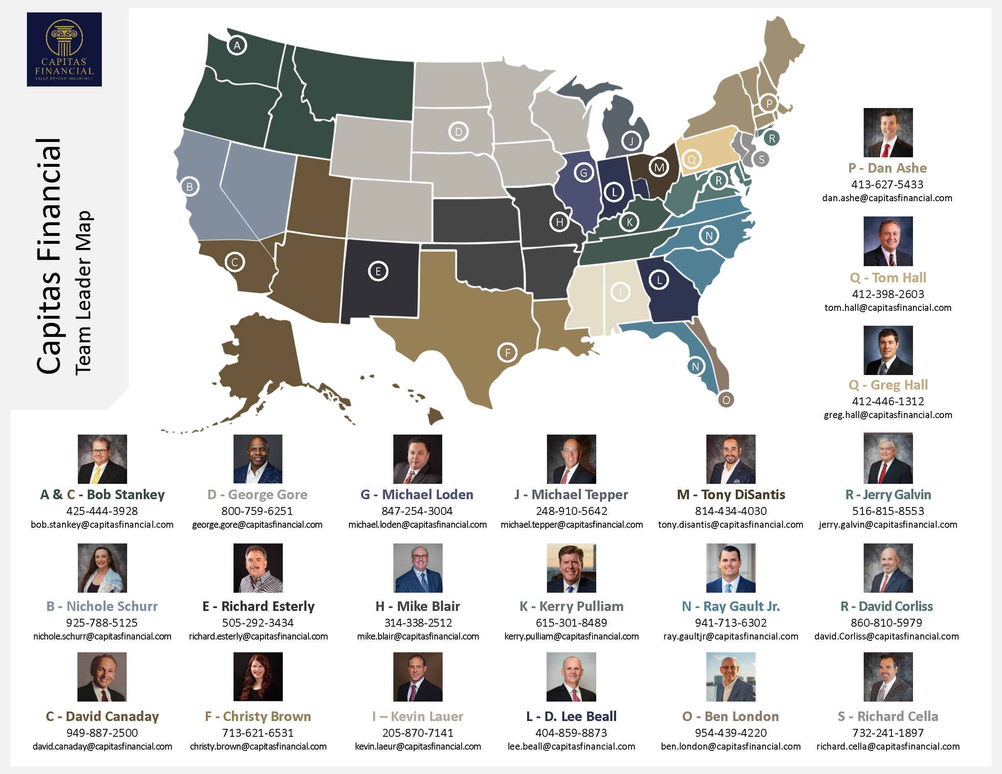
Capitas Financial Team Leader Map
CAPITAS PRIVATE WEALTH | FOR FINANCIAL PROFESSIONAL USE ONLY
6
Notes:
Designation Descriptions & Sponsoring Organization
AEP® - Accredited Estate Planner®; National Association of Estate Planners & Councils
AWMA® - Accredited Wealth Management AdvisorSM; The American College
CASL® - Chartered Advisor for Senior Living; The American College
CFP® - Certified Financial Planner™; Certified Financial Planner Board of Standards, Inc.
ChFC® - Chartered Financial Consultant; The American College
CLU® - Chartered Life Underwriter; The American College
CRPS® - Chartered Retirement Plans SpecialistSM; The American College
LUTCF® - Life Underwriter Training Council FellowSM; NAIFA & The American College
TEP - Trust and Estate Practitioner; Society of Trust and Estate Practitioners
Accredited Degrees Earned
MBA - Master of Business Administration;
MSF - Master of Finance
MSFP - Master in Financial Planning
MSFS - Master of Science in Financial Services
The Accredited Estate Planner® (AEP®) designation is owned and issued by the National Association of Estate Planners & Councils.
The AWMA®, CASL® , ChFC®, CLU®, and CRPS® marks are the property of The American College, which reserves sole rights to its use, and is used by permission.
Certified Financial Planner Board of Standards, Inc. (CFP Board) owns the certification marks CFP® and CERTIFIED FINANCIAL PLANNER™ in the U.S., which it authorizes use of by individuals who successfully complete CFP Board's initial and ongoing certification requirements.
NAIFA is the sole owner of the LUTCF® trademark and the College is NAIFA’s appointed administrator of the designation and the sole owner of the education program.

Slide 7








Capitas Private Wealth Centers
Capitas Private Wealth Centers are only a phone call away for Capitas local Point-of-Sale to engage for the Advisors and Clients they support.
Wealth Transfer & Estate Planning
Business Planning & Succession
Executive Planning
Premium Finance
ENGAGE EACH CENTER THROUGH
Private Wealth Presentations
Case Consultation
Advisor Training
In the Field at Point-of-Sale
CAPITAS PRIVATE WEALTH | FOR FINANCIAL PROFESSIONAL USE ONLY
7
Notes:
Capitas Private Wealth Centers were created to provide National Industry Leading expertise to Capitas Point-of-Sale Professionals and the Advisors they support. Each center has significant expertise that can be added via Capitas Private Wealth Presentations, Case Consultation, Advisor Training or in the field at Point-of-Sale. Capitas Private Wealth Centers are extremely diverse and include Wealth Transfer and Estate Planning, Premium Finance, Business Planning including Succession Planning and Valuation and Executive Planning. Capitas Private Wealth Centers are only a phone call away for Capitas local Point-of-Sale to engage for the Advisors and Clients they support.

Slide 8

Business Planning & Succession
Capitas brings over 45 years of consulting experience with primary emphasis on the tax and financial considerations affecting the creation, preservation and perpetuation of wealth.
EXPERTISE
Capitas’ practice focus is on business exit planning, business succession, business valuations and business value enhancement, personal and financial risk management and gift and estate planning for business owners and high net worth individuals and their families.
Business Planning
Valuation
Wealth Transfer
Estate Planning
Multi-Generational Planning
45+
years of consulting experience
CAPITAS PRIVATE WEALTH | FOR FINANCIAL PROFESSIONAL USE ONLY
8
Notes:
Expertise: Business Planning, Valuation, Wealth Transfer, Estate Planning, Multi-Generational Planning
Capitas brings over 45 years of consulting experience with primary emphasis on the tax and financial considerations affecting the creation, preservation and perpetuation of wealth. Capitas’ practice focus is on business exit planning, business succession, business valuations and business value enhancement, personal and financial risk management and gift and estate planning for business owners and high net worth individuals and their families.

Slide 9
Executive Planning (Individual Strategies)
Capitas’ Executive Benefit Solutions (EBS) specializes in executive planning.
The consultants and technical specialists analyze and create plans and financing solutions to meet the needs of executives in public, privately held as well as non-profit organizations. The team includes professionals with expertise in the areas of tax, accounting, law, actuarial science, and finance.
EXPERTISE
Executive Planning (Individual Strategies)
TEAM EXPERTISE INCLUDES
Tax
Accounting
Law
Actuarial Science
Finance
CAPITAS PRIVATE WEALTH | FOR FINANCIAL PROFESSIONAL USE ONLY
9
Notes:
Expertise: Executive Planning (Individual Strategies)
Capitas’ Executive Solutions (ES) practice specializes executive planning. The consultants and technical specialists analyze and create plans and financing solutions to meet the needs of executives in public, privately held as well as non-profit organizations. The team includes professionals with expertise in the areas of tax, accounting, law, actuarial science, and finance.

Slide 10
Premium Finance
Capitas brings over 40 years of experience working in the financial services industry working with Ultra High Net worth Advisors, Bankers, CPAs and Attorneys on a national basis.
EXPERTISE
Our experts provide advanced custom-tailored solutions for: estate, business and family generational planning with a focus on ultra high net worth clients. They are extremely knowledgeable in the complex area of Premium Financing strategies including the unique tax and financial considerations affecting the creation and monitoring of cases.
Premium Finance
Lending Resources
Loan Renewal and Monitoring
40+
years of financial services experience
CAPITAS PRIVATE WEALTH | FOR FINANCIAL PROFESSIONAL USE ONLY
10
Notes:
Expertise: Premium Finance, Lending Resources, Loan Renewal and Monitoring
Capitas brings over 40 years of experience working in the financial services industry working with Ultra High Net worth Advisors, Bankers, CPAs and Attorneys on a national basis. Our experts provide advanced custom-tailored solutions for: estate, business and family generational planning with a focus on ultra high net worth clients. They are extremely knowledgeable in the complex area of Premium Financing strategies including the unique tax and financial considerations affecting the creation and monitoring of cases.

Slide 11

Underwriting
Capitas’ Director of Underwriting has more than 30 years of experience in the life and health insurance industry, specializing in impaired risk and financial life underwriting.
EXPERTISE
He works closely with Capitas principals, marketing and new business staff, as well as point-of-sale, providing support of field underwriting pre-sale questions and informal and formal life insurance application processing. He assists in reviewing medical and financial information of impaired risk, rated and declined life insurance applicants and provides recommendations on how best to present and submit client applications in order to obtain the best offer, product, pricing and placement.
Medical Underwriting
Financial Underwriting
Reinsurance
30+
years in the life and health insurance industry
CAPITAS PRIVATE WEALTH | FOR FINANCIAL PROFESSIONAL USE ONLY
11
Notes:
Expertise: Medical Underwriting, Financial Underwriting, Reinsurance
Capitas’ Director of Underwriting has more than 30 years of experience in the life and health insurance industry, specializing in impaired risk and financial life underwriting. He works closely with Capitas principals, marketing and new business staff, as well as point-of-sale, providing support of field underwriting pre-sale questions and informal and formal life insurance application processing. He assists in reviewing medical and financial information of impaired risk, rated and declined life insurance applicants and provides recommendations on how best to present and submit client applications in order to obtain the best offer, product, pricing and placement.

Slide 12
Wealth Transfer & Estate Planning
Capitas brings over 45 years of experience working in the financial services industry.
Our experts have spent their careers working with Ultra High Net Worth Advisors, Bankers, CPAs and Attorneys on a national basis. They are extremely knowledgeable in the complex area of wealth transfer strategies and legacy planning for high-net-worth families including the unique tax and financial considerations affecting the creation, preservation and perpetuation of wealth.
EXPERTISE
Business Planning
Valuation
Wealth Transfer
Estate Planning
Multi-Generational Planning
Premium Finance
45+
years of financial services experience
CAPITAS PRIVATE WEALTH | FOR FINANCIAL PROFESSIONAL USE ONLY
12
Notes:
Expertise: Business Planning, Valuation, Wealth Transfer, Estate Planning, Multi-Generational Planning, Premium Finance
Capitas brings over 45 years of experience working in the financial services industry. Our experts have spent their careers working with Ultra High Net Worth Advisors, Bankers, CPAs and Attorneys on a national basis. They are extremely knowledgeable in the complex area of wealth transfer strategies and legacy planning for high-net-worth families including the unique tax and financial considerations affecting the creation, preservation and perpetuation of wealth.

